Slide 1
My Life, My Recovery
How Addiction Affects Diet & Appetite
Melanie Savoy, LDAC

Slide 2

How Substance Misuse Disrupts Nutrition

Slide 3
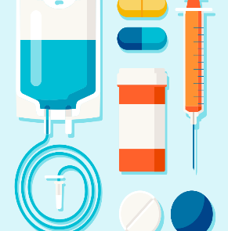
How Substance Misuse Affects Diet & Nutrition
Below are some of the ways that drugs and alcohol can interfere with nutrition and diet:
Failing to eat
Eating poorly
Malnourishment
Overeating
Organ damage
Immune system damage
Gastrointestinal disorders
Hypoglycemia
Notes:
Substance use can have many long-term effects on health and nutrition. Substances vary in their effects, but many of them disrupt physiological functioning and impair the body’s ability to receive proper nourishment.
Below are some of the ways that drugs and alcohol can interfere with nutrition and diet:
Failing to eat: Individuals may have a suppressed appetite or forget to eat while under the influence.
Eating poorly: Individuals with SUDs tend to prioritize their substance misuse over eating properly. As a result, their diets can be poor and lack sustenance.
Malnourishment: Malnourishment can result from failing to eat consistently over time or from the body’s inability to absorb nutrients necessary for biological processes.
Overeating: Eating too much can lead to obesity and a number of health conditions associated with excess body fat.
Organ damage: Substance misuse can damage the liver, stomach lining, pancreas, and intestines, all of which contribute to the proper absorption, digestion, and storage of nutrients.
Immune system damage: Substances such as alcohol and opiates can suppress the immune system and make the user more susceptible to infections and illnesses.
Gastrointestinal disorders: Alcohol and other substances can contribute to chronic gastrointestinal tract inflammation, irritable bowel syndrome, leaky gut syndrome, pathogenic bacterial overgrowth, fungal intestinal infections, and acid reflux.
Hypoglycemia: Low blood sugar can be caused by a lack of sustenance or proper diet.

Slide 4

Alcohol
Heavy alcohol use interferes with the breakdown and absorption of nutrients due to damage of the stomach lining and digestive enzyme deficiencies. Further, chronic alcohol use can significantly harm the pancreas and the liver.
Notes:
The pancreas produces enzymes and pro-enzymes for the digestion of lipids, proteins, carbohydrates, and hormones that delicately balance blood sugar levels, while the liver metabolizes toxins, such as alcohol and drugs.
Damage to these two vital organs can lead to an imbalance of electrolytes, protein, calories, and fluids.

Slide 5

Alcohol (continued)
Vitamin deficiencies can cause anemia (deficiency of healthy red blood cells) and neurological issues:
Anemia can lead to frequently feeling cold, fatigue, and dizziness, as well as experiencing headaches and shortness of breath.
A serious complication caused by a lack of thiamine, or B1, is Wernicke-Korsakoff Syndrome, which can lead to severe learning and memory problems.
Notes:
Persistent alcohol misuse can cause severe nutritional and vitamin deficiencies. The most common deficiencies include:
Folic acid.
Vitamin B1 and B6.
Thiamine, or B1 (as many as 80% of people with alcohol use disorder have insufficient thiamine).

Slide 6
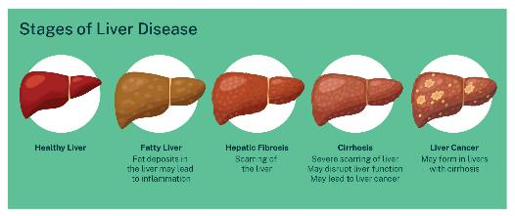
Diseases from Alcohol
Alcohol misuse can cause:
Liver damage including cirrhosis
Heart dysfunctions
Cancers
Pancreatitis
Diabetes
High blood pressure
Seizures
Notes:
Picture: https://www.google.com/url?sa=i&url=https%3A%2F%2Fliver.org.au%2Fyour-liver%2Fliver-failure%2F&psig=AOvVaw22SIYeQ__LNEg-B3DXbp_V&ust=1717146561343000&source=images&cd=vfe&opi=89978449&ved=0CBIQjhxqFwoTCPjHysiDtYYDFQAAAAAdAAAAABAE

Slide 7
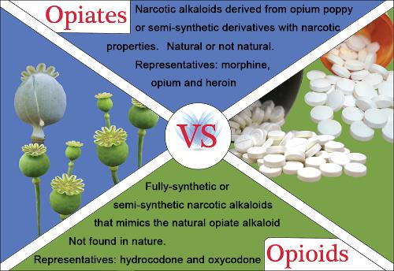
Opioids/Opiates
Opioid and Opiate use can cause:
Decreased appetite
Decreased food consumption
Slower metabolism
Constipation
Notes:
Picture: https://www.google.com/url?sa=i&url=http%3A%2F%2Fmsfda.net%2Fwp-content%2Fuploads%2F2019%2F01%2FOnline-Course-Manual-Opioid-Epidemic-Awareness.pdf&psig=AOvVaw0h9DVTJu9Qgr7-9Wc3cR2W&ust=1717146646724000&source=images&cd=vfe&opi=89978449&ved=0CBEQjhxqFwoTCMjwjvWDtYYDFQAAAAAdAAAAABAE
When someone begins regularly misusing opioids, they often begin to develop disordered eating. There are several patterns of eating that result from appetite suppression due to excess dopamine production and the competing priorities of eating and continuing drug use.
In individuals using opioids, serious nutritional deficiencies of key proteins, fats, vitamins and minerals exist which disrupt their ability to digest carbohydrates efficiently.

Slide 8
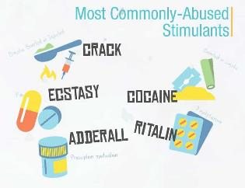
Stimulants
Some problems with stimulant use and the associated malnutrition include:
Suppressed immune system.
Muscle wasting.
Respiratory muscle strength inadequate for forceful coughing => risk of pulmonary infection and lengthened recovery duration.
Impaired healing of wounds.
Low levels of phosphate, magnesium, and potassium.
Cardiac rhythm disturbances.
Low body temperature.
Psychological and cognitive issues (depression, low self-esteem, apathy, confusion, and a lack of sex drive).
Notes:
Picture: https://www.google.com/url?sa=i&url=http%3A%2F%2Fmsfda.net%2Fwp-content%2Fuploads%2F2019%2F01%2FOnline-Course-Manual-Opioid-Epidemic-Awareness.pdf&psig=AOvVaw0h9DVTJu9Qgr7-9Wc3cR2W&ust=1717146646724000&source=images&cd=vfe&opi=89978449&ved=0CBEQjhxqFwoTCMjwjvWDtYYDFQAAAAAdAAAAABAE
Stimulants cause decreased appetite.
In some individuals using stimulants, they will often stay up for days at a time and repeatedly use the substance.
These binge patterns may lead to dehydration and electrolyte imbalances due to a significant decrease in appetite and inattention to nutrition.
Consistent, long-term use can lead to severe weight loss and malnutrition.

Slide 9

Cannabis/Marijuana
When someone doesn’t have enough omeg-3 and omega-6 fatty acids, they may experience:
Inferior wound healing.
Increased risk of infection.
Dry rash and other inflammatory skin issues.
Notes:
Marijuana can increase a user’s appetite, particularly for junk food, which doesn’t contain essential vitamins and nutrients.
Over time, a chronic marijuana user may gain an excessive amount of weight due to overeating and making poor food choices.
Regular marijuana users may also be deficient in essential omega-3 and omega-6 fatty acids.

Slide 10

Cannabis/Marijuana (continued)
The overconsumption of unhealthy food can lead to obesity and increase the risk of conditions such as:
Heart disease
High blood pressure
Stroke
Cancer (breast, gallbladder, colon, and endometrial)
Type 2 diabetes
Sleep apnea
Reproductive problems
Gallstones

Slide 11
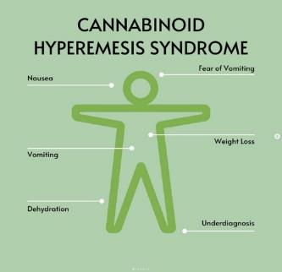
Cannabinoid Hyperemesis Syndrome
CHS is a condition that can occur due to prolonged, high-dose cannabis use.
It manifests as recurrent nausea, vomiting, diarrhea, and cramping abdominal pain.
This can result in:
Decreased appetite
Decreased food consumption
Dehydration
Malnourishment
Notes:
Picture: https://www.google.com/url?sa=i&url=https%3A%2F%2Fsoundcloud.com%2Fmartin-mawhinney-25852997%2Fcannabinoid-hyperemesis-syndrome&psig=AOvVaw26wdKrM7h6J8Dc4rECfmru&ust=1717146720839000&source=images&cd=vfe&opi=89978449&ved=0CBIQjhxqFwoTCOD80ZSEtYYDFQAAAAAdAAAAABAE

Slide 12
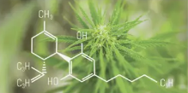
Cannabinoid Hyperemesis Syndrome Explained
Etiology
Phases
Treatment
Not fully understood
Tetrahydrocanabinol (THC) is a necessary component, but cannabidiol (CBD) and cannabigerol (CBG) may contribute
Most cannabis users don’t develop, so an unknown genetic or environmental trigger may have role
Prodromal
Days, weeks, or months of mild symptoms
Hyperemetic
24 to 48 hours of intense vomiting, epigastric or diffuse abdominal pain, sweating, and flushing
Recovery
Begins when vomiting ends and only after patients cease using cannabis
Symptom management
Cannabis cessation
Application of capsaicin-based creams to abdomen
Traditional antiemetic medications usually aren’t effective

Slide 13

Group Discussion
Notes:
What are your thoughts about how these substances impact health and diet?
How is/was your diet affected by your addiction?

