Slide 1
My Life, My Recovery
How Nutrition Helps with Recovery
Melanie Savoy, LDAC

Slide 2
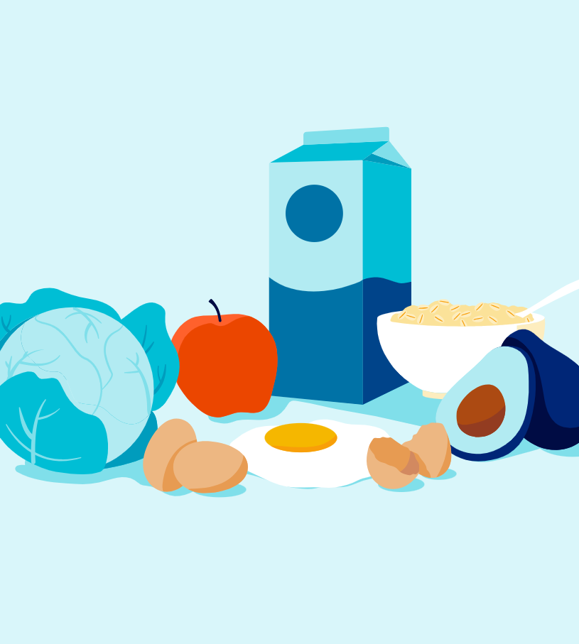
How Good Nutrition Affects Recovery

Slide 3
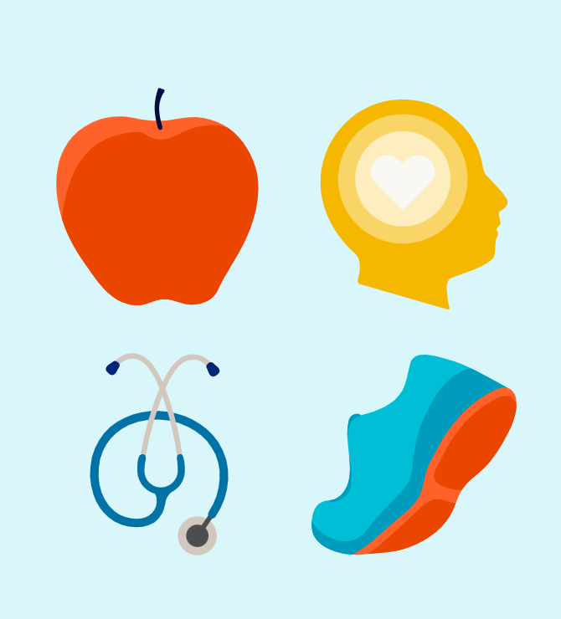
Addiction & Diet
Long-term substance misuse puts remarkable stress on the mind and body. Even short-term addiction can take a huge toll on the body as it is forced to work overtime to eliminate toxic substances and defend itself against the damage they do.
Proper nutrition can help both the brain and the body heal from chronic substance misuse and increase the user’s odds of getting and staying sober.

Slide 4
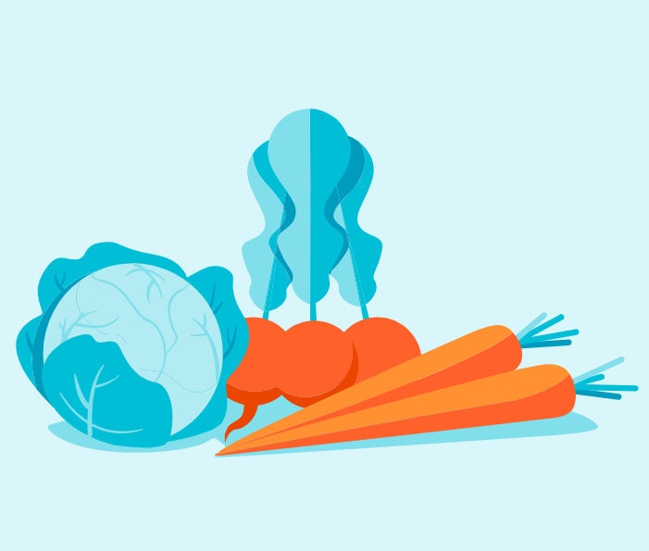
Benefits of a Healthy, Balanced Diet
Repair of damage to organs and tissues
Improved immune defenses (preventing and fighting diseases)
Increased energy
Improved mood
Sleeping better
Improving withdrawal symptoms/PAWS
Reduced risk of relapse

Slide 5

Nutrition & the Recovery Process
Food as Fuel
Eating Habits Matter
Drink Fluids
Eat Healthy
Fewer Cravings & Prolonged Abstinence
Adequate Nutrition is a Key to Recovery
Notes:
Food provides fuel for the body and mind, with different nutrients impacting mood and overall health in various ways.
A person with a substance use disorder is more likely to relapse when they have poor eating habits.
During recovery from substance use, dehydration is common. It is important to get enough fluids during and in between meals. Appetite usually returns during recovery. It is important to eat healthy meals and snacks and avoid high-calorie foods with low nutrition, such as sweets.
Increasing consumption of healthy fuel, such as fatty acids, B vitamins, zinc, and antioxidants can increase neurotransmitter signaling in the brain.
Depressed neurotransmitter signaling is associated with depression and suicidal thoughts that sometimes occur with SUD, so increasing the consumption of these healthy nutrients can reverse these negative symptoms.
With adequate nutrition to power the brain, a person in recovery may experience fewer cravings and prolonged abstinence.
The benefits of adequate nutrition can be key during recovery and treatment, so learning about improving nutrition can aid a person’s recovery journey.
DietNutritionandSubstanceUseDisorder.pdf (usu.edu)
Jensen, M., Savoie Roskos, M., Yaugher, A., Sulzer, S. (2019). Anxiety and depression: Can diet help? All
Current Publications, Paper 1978, Utah State University Extension. https://digitalcommons.usu.edu/
extension_curall/1978
Du, J., Zhu, M., Bao, H., Li, B., Dong, Y., Xiao, C., … Vitiello, B. (2014). The role of nutrients in protecting mitochondrial function and neurotransmitter signaling: Implications for the treatment of depression, PTSD, and suicidal behaviors. Critical Reviews in Food Science and Nutrition, 56(15), 2560–2578. doi: 10.1080/10408398.2013.876960
Jeynes, K. D., & Gibson, E. L. (2017). The importance of nutrition in aiding recovery from substance use disorders: A review. Drug and Alcohol Dependence, 179, 229–239. doi: 10.1016/j. drugalcdep.2017.07.006

Slide 6
How Nutrients Affect the Body
Definition:
Vitamins and minerals needs by the body in very small amounts
Definition:
The nutrients we need in larger quantities that provide us with energy
Micronutrients
Macronutrients
There are six nutrient groups derived from food that are considered essential, and they can be divided into micronutrients and macronutrients.
Examples:
Vitamins
Minerals
Phytochemicals
Examples:
Fats
Proteins
Carbohydrates
Notes:
Macronutrients are those your body needs in large amounts each day to function. Micronutrients are just as important, but you don’t need to consume as much of them to stay healthy.

Slide 7
Vitamins & Minerals
Vitamins
  Support the immune system
  Develop strong bones and teeth
  Facilitate calcium absorption
  Keep skin and hair healthy
  Facilitate protein and carbohydrate metabolization
  Aid function of the brain and nervous system
Vitamins and minerals are essential for the body since they help fight infections and assist in wound healing. They also help strengthen our bones and regulate hormones.
Minerals
  Healthy blood pressure
  A healthy immune system
  Proper blood clotting
  Oxygen transfer
  Tooth decay prevention
Notes:
Major minerals are essential because it allows your body to keep appropriate hydration levels, plus healthy hair and bones.
The human body needs 13 different essential vitamins to stay healthy. They are categorized by fat solubility or water solubility. Fat-soluble vitamins are:
Vitamin A
Vitamin D
Vitamin E
Vitamin K
The water-soluble vitamins are:
Vitamin B-1 (thiamine)
Vitamin B-2 (riboflavin)
Vitamin B-3 (niacin)
Vitamin B-5 (pantothenic acid)
Vitamin B-6
Vitamin B-7 (biotin)
Vitamin B-9 (folate or folic acid)
Vitamin B-12 (cyanocobalamin)
Vitamin C
The other type of micronutrient is minerals. Within this category is another division: major and trace minerals. The major minerals are:
Calcium
Magnesium
Phosphorus
Potassium
Sodium
Sulfur
These minerals allow your body to keep appropriate hydration levels, plus healthy hair and bones. The trace minerals you need are:
Chromium
Copper
Fluoride
Iodine
Iron
Manganese
Molybdenum
Selenium
Zinc

Slide 8

Protein, Fat & Fatty Acids
Proteins are often referred to as the building blocks of the body. While it is most closely associated with muscle building, protein is found in every cell of the body, from bones to skin and hair.
Healthy fats are necessary for:
  Hormone production
  Blood clotting
  Muscle function
  Blood sugar regulation
  Brain function
  Vitamin and mineral absorption
  Immune function
Notes:
Examples of healthy fats:
Nuts
Seeds
Avocado
Fatty fish
Vegetable oils (olive oil)
Dietary Guidelines for Americans indicates that 20% to 35% of daily calorie intake should come from healthy fats.

Slide 9
Carbohydrates
Carbohydrates are essential for the function of the central nervous system and brain. 45% to 65% of daily calories should come from carbohydrates.
Simple
Complex
  Simple carbs supply a quick burst of energy that does not last
  Examples:
  Table Sugar
  Candy
  Carbonated Beverages
  Fruit juice
  Complex carbs take longer to digest and are a more stable source of energy that simple carbohydrates
  Examples:
  Whole grains
  Most vegetables
  Beans
  Legumes

Slide 10
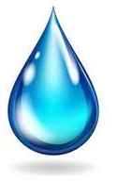
Water
Why Drink Water?
You body is ~60% water and water plays vital roles in nearly every function.
Examples include
facilitating brain function
improving mood
flushing out toxins
transferring nutrients between cells
Helps lose weight
Promotes healthy skin
Fights infection
Helps get rid of toxins from the body
Promotes a healthy heart
Helps prevent joint pains and arthritis
Helps boost energy
Helps prevent constipation
Reduces the risk of cancer
Improves Productivity
How much Should you Drink?
The recommended daily fluid intake varies depending on factors such as gender, physical activity, and climate.
Men should drink about 15.5 cups (3.7 liters) of fluids per day.
Women should drink about 11.5 cups (2.7 liters) of fluids per day.

Slide 11

Nutrition: Tips to Succeed
Stick to regular mealtimes (at least three meals a day)
Eat nutritious meals and snacks i.e. low in fat
Get more protein, complex carbohydrates, and dietary fiber
Talk to medical provider about vitamin and mineral supplements including B-complex, zinc, and vitamins A and C.
Get regular physical activity/exercise.
Reduce caffeine
Drink plenty of water
Monitor your sugar intake
Get enough sleep
Work on your recovery process every day
Notes:
Picture: https://www.google.com/url?sa=i&url=https%3A%2F%2Fwww.hoffeldgroup.com%2F3-scientifically-proven-behaviors-that-lead-to-success%2F&psig=AOvVaw1n7nhv1Oy4jWV0IU410UH9&ust=1717146916361000&source=images&cd=vfe&opi=89978449&ved=0CBIQjhxqFwoTCLi2rvOEtYYDFQAAAAAdAAAAABAE

Slide 12

Foods for Addiction Recovery
Tackle common everyday moments where we can make a difference by improving on what matters most to you
Poultry & Fish: contain tyrosine, an amino acid essential in creating dopamine and norepinephrine. This is a good way to enhance your mood and well-being.

Slide 13
Foods for Addiction Recovery
Tackle common everyday moments where we can make a difference by improving on what matters most to you.
Poultry & Fish: contain tyrosine, an amino acid essential in creating dopamine and norepinephrine. This is a good way to enhance your mood and well-being.
Yogurt: Repairing the digestive system is essential for increasing your body’s absorption of nutrients. Yogurt contains probiotics that can help your gut build up a healthy microbiome in recovery.
Vegetables: Any and all vegetables provide a range of vitamins, minerals, fiber and other key nutrients that the body needs for fuel and function. Leafy greens like kale, cruciferous vegetables like broccoli and starchy veggies like potatoes all play an essential role.
Bananas: a good source of the amino acid tryptophan, which is needed to produce serotonin for healthy sleep. Bananas are also a good source of potassium, vitamin B6 and vitamin C.
Whole Grains: provide the body with complex carbs that keep you feeling fuller for longer, and they also contribute much-needed fiber to help the digestive system recover. You can often find whole-grain versions of foods like bread and pasta to replace their white flour counterparts.
Blueberries: contain antioxidants, which help boost the immune system and reduce the overrun of free radicals and other toxins.
Notes:
Nutrition Guide For Addiction Recovery - Gateway Foundation

Slide 14

Group Discussion
Notes:
Would you say you have a healthy relationship with food?
Why or why not?
What habits do you want to work on changing?
What are one or more things you can do differently with you diet?
What are your nutrition goals?
What are you currently doing to achieve these goals?

