Slide 1
My Life, My Recovery
The Benefits of Exercise in Recovery
Melanie Savoy, LDAC

Slide 2
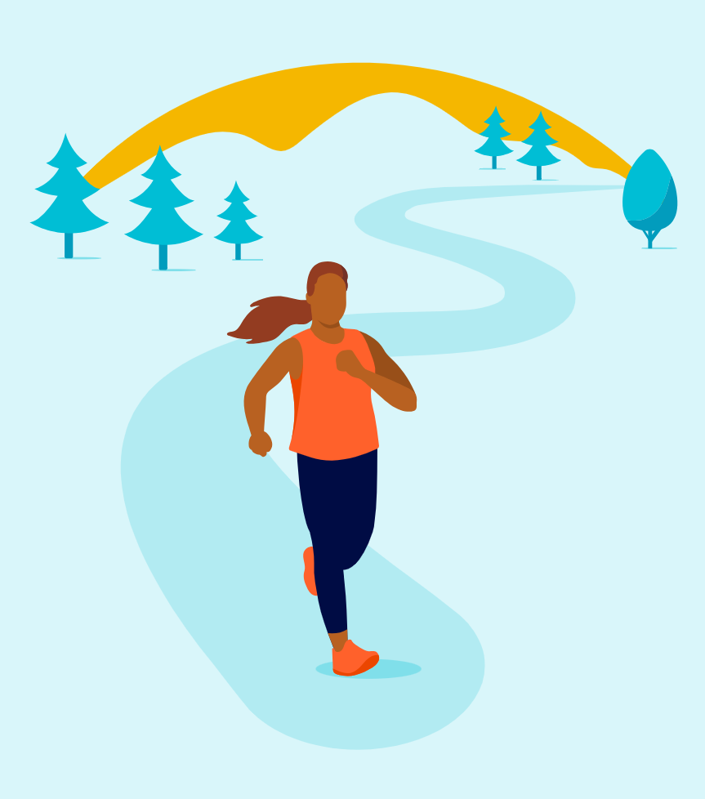
Exercise Benefits Recovery

Slide 3
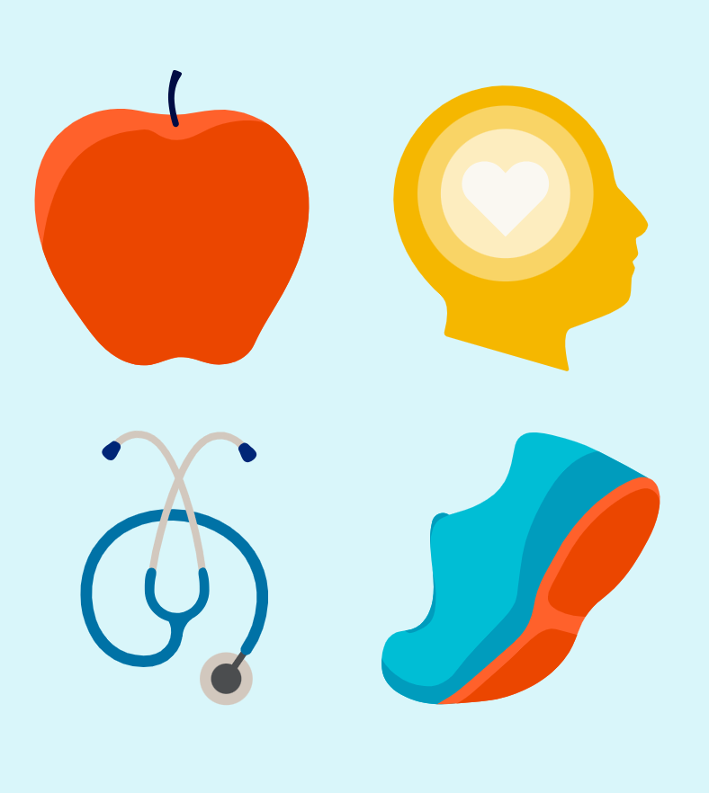
Exercise & Recovery
A multi faceted approach to working on recovery is the most beneficial.
Holistic approaches can make a significant difference.
Integrating exercise into the recovery process can have profound effects on both mental and physical well-being.

Slide 4

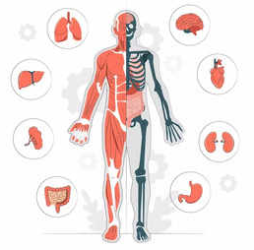
Physiological of Benefits of Being Active
Regular activity helps treat diseases such as:
Regular exercise can increase the brain’s amount of new nerve connections, which helps the brain’s healing process in recovery
  Diabetes
  High blood pressure
  High cholesterol
  Stroke
  Cancer
  Arthritis
  Osteoporosis
  Anxiety
  Depression
  Helps control weight
Notes:
https://www.mayoclinic.org/healthy-lifestyle/fitness/in-depth/exercise/art-20048389#:~:text=Regular%20exercise%20helps%20prevent%20or%20manage%20many%20health,Many%20types%20of%20cancer.%208%20Arthritis.%20More%20items

Slide 5

Psychological of Benefits of Being Active
Reduces levels of stress and anxiety
Increases energy
Improves mood
Promotes better sleep
Improves some aspects of cognitive function
Reliable routine
Filling spare time
Higher self-esteem
Reduces risk of relapse
Notes:
Reduced risk of relapse=improved mood and releases endorphins
How Exercise Benefits Addiction Recovery -Gateway Foundation
https://www.mayoclinic.org/healthy-lifestyle/fitness/in-depth/exercise/art-20048389#:~:text=Regular%20exercise%20helps%20prevent%20or%20manage%20many%20health,Many%20types%20of%20cancer.%208%20Arthritis.%20More%20items

Slide 6

How Does Exercise Help in the Recovery Process?
Regular exercise can increase the amount of oxygen and nutrients flowing to your body’s muscles. This results in a greater capacity to release energy throughout the day.
These higher energy levels then make daily tasks easier and often boost the ability to resist the urge to use substances.
Exercise provides structure and routine:
Helps with staying busy
Relieves stress
Boosts mood
Helps with self esteem
Improves sleep
Meeting new people
Notes:
Exercise Curbs Cravings: Research has shown that regular exercise can lead to an increase of abstinent days. One study’s participants who struggled with substance use disorder committed to routine moderate aerobic exercise for 12 weeks and saw significantly better substance use outcomes than those who did not. Exercising moves blood through the heart quicker, regular exercise can increase the amount of oxygen and nutrients flowing to your body’s muscles. This increase in nourishment causes the body to grow stronger and have a greater capacity to release energy throughout the day. These higher energy levels then make daily tasks easier and often boost the ability to resist the urge to use drugs. When paired with regular cognitive-behavioral therapy, exercise is an especially effective method for helping people quit smoking by meeting psychological and physiological needs that a nicotine replacement does not. For these reasons, many former smokers take up exercise to help them quit.
Filling time: Exercise is a great outlet for this extra time and can take up several hours of the week. It is generally good to keep yourself busy during addiction recovery, especially in the beginning phases. Following a regular exercise routine takes away the need to make split decisions about what to do with spare time throughout the day.
How Exercise Benefits Addiction Recovery -Gateway Foundation

Slide 7
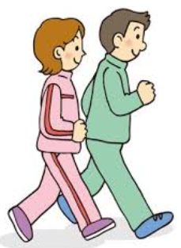
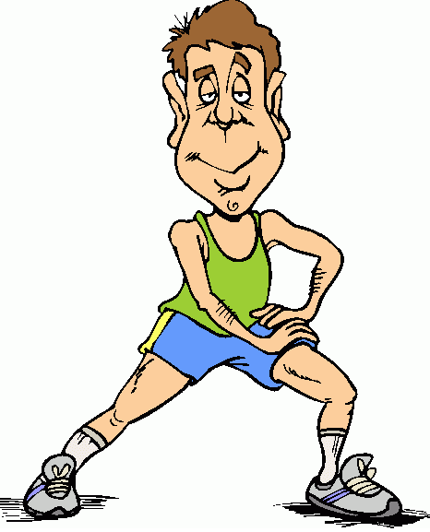
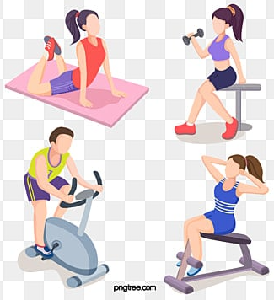
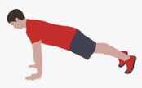
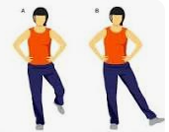
Four Types of Exercise
Endurance Exercises
Flexibility Exercises
Commonly called Aerobic exercises => increases breathing an heart rate
Aim for at least 150 minute/week
Try brisk walking, swimming, jogging, cycling, dancing, or classes
Also referred to as stretching
Aim for a program of stretching every day or at least three to four times a week
Try neck rolls, shoulder rolls, hamstring stretches and ankle rolls
Strength Exercises
Balance Exercises
Also called resistance training
Incorporate this into your daily exercise routine
Try lifting weights, doing push-ups, squatting, or using a resistance band
Helps to improve stability and prevent falls
Aim for completing balance exercises twice a week
Try standing on one foot, lifting your leg out to the side or behind you
Notes:
https://www.health.harvard.edu/exercise-and-fitness/the-4-most-important-types-of-exercise
Endurance Exercises:
Commonly referred to as aerobic exercises.
Increases your breathing and heart rate.
Improves the health of your heart, lungs, and circulatory system.
Aerobic exercise also helps relax blood vessel walls, lower blood pressure, burn body fat, lower blood sugar levels, reduce inflammation, and boost mood.
Examples include:
Brisk walking or jogging
Marching in place
Yard work (mowing, raking)
Dancing
Swimming
Biking
Climbing stairs or hills
Playing tennis or basketball
Strength Exercises:
Also referred to as resistance training.
Increases your muscular strength and builds muscle mass.
Stimulates bone growth, lowers blood sugar, assists with weight control, improves balance and posture, and reduces stress and pain in the lower back and joints.
Examples include:
Lifting weights
Carrying groceries
Arm and leg curls
Push-ups
Squats
Lifting your body weight
Using a resistance band
Flexibility Exercises:
Aim for a program of stretching every day or at least three or four times per week.
Also referred to as stretching
Improves and helps maintain flexibility
Increases your range of motion and reduces pain and the risk for injury
Examples include:
Repetitive motion such as marching in place or arm circles
Balance Exercises:
Tai Chi, a "moving meditation" that involves shifting the body slowly, gently, and precisely, while breathing deeply.
Improves balance and prevents falls.
Examples include:
Tai Chi
Yoga
Standing on one foot
Walking heel to toe, with your eyes open or closed

Slide 8






What’s Next?*
Research a regime or create our own*
Get the necessary items (sneakers, clothes, etc.)
Make a schedule
Track your progress
Make exercise fun
* Before starting any exercise regime, check with your doctor
Notes:
Research a regime or create your own regime
Decide what type of fitness you are interested in
Start with your end goal and work backwards
Get the necessary items (sneakers, equipment, clothes etc.)
In order for you to be successful it’s important to gather all the tools you need
Make a schedule
Put your plan into action
Track your progress
Fitness trackers hold you accountable and they show your growth and progress
Make exercise fun
This isn’t about excessive exercise, this is about changing your exercise behavior so that you enjoy it

Slide 9

Group Discussion
Group Discussion
Notes:
Do you currently exercise?
Why or why not?
What habits do you want to work on changing?
What are your exercise goals?
What are you currently doing to achieve these goals?

