Slide 1
My Life, My Recovery
Benefits of Healthy Sleep Habits in Recovery
Melanie Savoy, LDAC

Slide 2

Healthy Sleep Aids Recovery

Slide 3
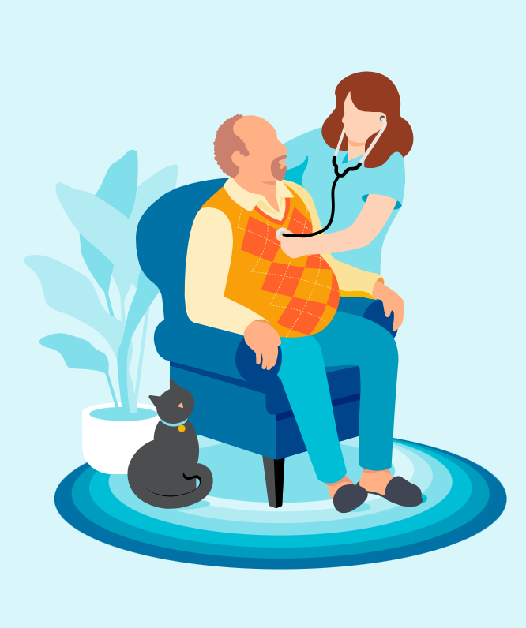
Addiction and Sleep
Long-term substance misuse puts remarkable stress on the mind and body.
Sleep deficiency is linked to a higher risk of:
  Cardiovascular disease
  Stroke
  Diabetes
  Kidney disease

Slide 4
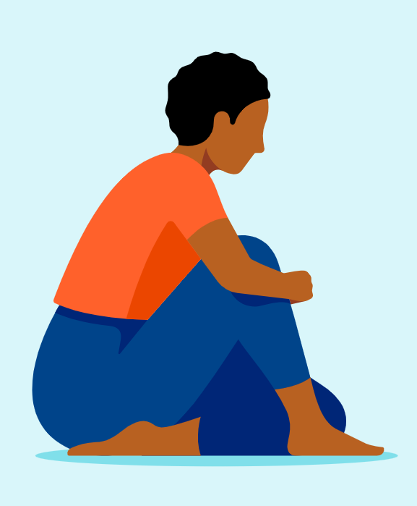
What is the Function of Sleep?
Rest and restore.
Adequate sleep improves memory, learning, increases attention and creativity and aids in concentration and decision making.
Healing and repair of cells takes place.
Sleep helps to maintain the balance of hormones in the body.
Allows the brain to focus on rebuilding and repairing.

Slide 5
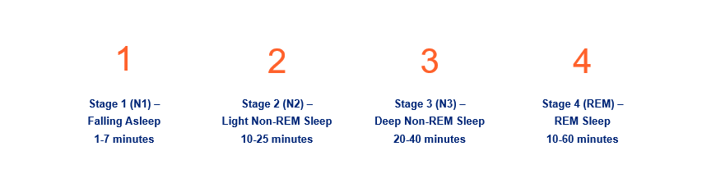
The Four Stages of Sleep
A person will typically go through four to six cycles per night; duration of each stage varies
Notes:
Copied from: https://www.sleepfoundation.org/stages-of-sleep
Stage 1
Stage 1, also called N1, is essentially when a person first falls asleep. This stage normally lasts just one to seven minutes.
During N1 sleep, the body has not fully relaxed, though the body and brain activities start to slow with periods of brief movements. There are light changes in brain activity associated with falling asleep in this stage.
It is easy to wake someone up during this sleep stage, but if a person is not disturbed, they can move quickly into stage 2. As the night unfolds, an uninterrupted sleeper may not spend much more time in stage 1 as they move through further sleep cycles.
Stage 2
During stage 2, or N2, the body enters a more subdued state including a drop in temperature, relaxed muscles, and slowed breathing and heart rate. At the same time, brain waves show a new pattern and eye movement stops. On the whole, brain activity slows, but there are short bursts of activity (Trusted Source National Library of Medicine, Biotech Information). The National Center for Biotechnology Information advances science and health by providing access to biomedical and genomic information. (View Source) that actually help resist being woken up by external stimuli.
Stage 2 sleep can last for 10 to 25 minutes during the first sleep cycle, and each N2 stage can become longer during the night. Collectively, a person typically spends about half their sleep time in N2 sleep.
Stage 3
Stage 3 sleep is also known as N3 or deep sleep, and it is harder to wake someone up if they are in this phase. Muscle tone, pulse, and breathing rate decrease in N3 sleep as the body relaxes even further.
The brain activity during this period has an identifiable pattern of what are known as delta waves. For this reason, stage 3 may also be called delta sleep or slow-wave sleep (SWS).
Experts believe that this stage is critical to restorative sleep, allowing for bodily recovery and growth. It may also bolster the immune system and other key bodily processes. Even though brain activity is reduced, there is evidence that deep sleep contributes to insightful thinking (Trusted Source National Library of Medicine, Biotech Information). The National Center for Biotechnology Information advances science and health by providing access to biomedical and genomic information. (View Source ), creativity (Trusted Source National Library of Medicine, Biotech Information). The National Center for Biotechnology Information advances science and health by providing access to biomedical and genomic information. (View Source ), and memory.
You spend the most time in deep sleep during the first half of the night. During the early sleep cycles, N3 stages commonly last for 20 to 40 minutes. As you continue sleeping, these stages get shorter, and more time gets spent in REM sleep instead.
Stage 4
During REM sleep, brain activity picks up, nearing levels seen when you are awake. At the same time, the body experiences atonia, which is a temporary paralysis of the muscles, with two exceptions: the eyes and the muscles that control breathing. Even though the eyes are closed, they can be seen moving quickly, which is how this stage gets its name.
REM sleep is believed to be essential to cognitive functions like memory (Trusted Source UpToDatex). More than 2 million healthcare providers around the world choose UpToDate to help make appropriate care decisions and drive better health outcomes. UpToDate delivers evidence-based clinical decision support that is clear, actionable, and rich with real-world insights. (View Source ), learning, and creativity (Trusted Source National Library of Medicine, Biotech Information). The National Center for Biotechnology Information advances science and health by providing access to biomedical and genomic information. (View Source ). REM sleep is known for the most vivid dreams, which is explained by the significant uptick in brain activity. Dreams can occur in any sleep stage, but they are less common and intense in the NREM periods.
Under normal circumstances, you do not enter a REM sleep stage until you have been asleep for about 90 minutes. As the night goes on, REM stages get longer, especially in the second half of the night. While the first REM stage may last only a few minutes, later stages can last for around an hour. In total, REM stages make up around 25% of sleep in adults.

Slide 6
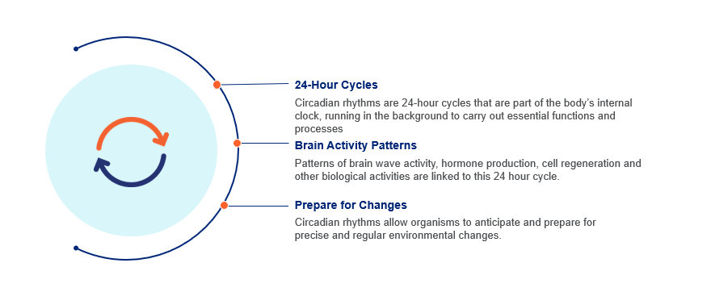
Circadian Rhythm

Slide 7
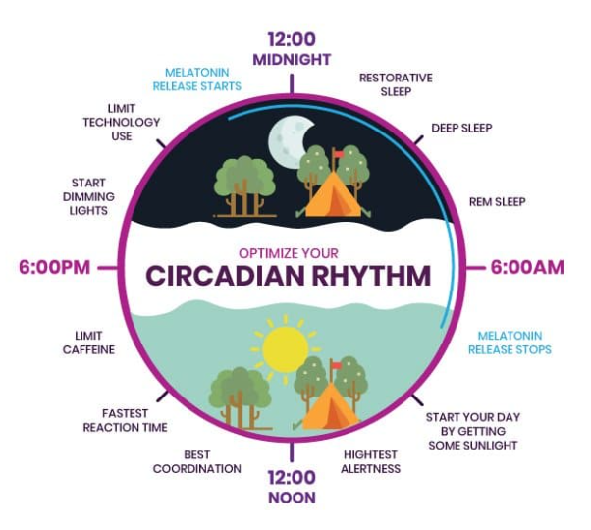
Circadian Rhythm
Notes:
Picture: https://www.google.com/url?sa=i&url=https%3A%2F%2Fwww.makegreatlight.com%2Fabout-us%2Fblog%2Fcircadian-rhythm-why-important-to-mental-health&psig=AOvVaw1_dz1ZGenfE1VRqO6qhEHI&ust=1717147193273000&source=images&cd=vfe&opi=89978449&ved=0CBIQjhxqFwoTCOCZov-FtYYDFQAAAAAdAAAAABAc

Slide 8
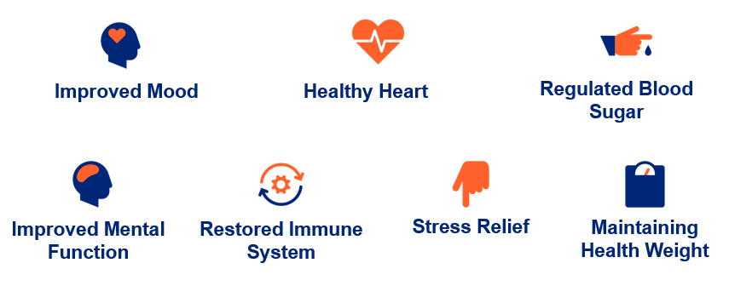
Benefits of Sleep
Notes:
https://www.sleepfoundation.org/how-sleep-works/benefits-of-sleep
Good Sleep for Good Health | NIH News in Health
Improved mood
Sleep restores the body and improves energy levels, so waking up well-rested can have a positive impact on an individual’s mood.
Healthy heart
Quality sleep promotes cardiac health. During sleep, heart rate slows down, and blood pressure decreases.
This means that during sleep, the heart and vascular system are able to rest.
Regulated blood sugar
Sleep impacts the body’s relationship with the hormone insulin, which helps blood sugar, or glucose, enter the body’s cells. The cells then use glucose as energy.
Sleeping seven hours or more each night helps ensure blood sugar is regulated in the body
Improved mental function
Sleep is necessary so the brain can grow, reorganize, restructure, and make new neural connections.
Restored immune system
The body produces cytokines during sleep, which support the immune system in fighting infections.
Stress relief
When people wake up refreshed, they avoid the stressors that come with functioning while sleep-deprived, such as poor performance, difficulty thinking clearly, and lack of energy.
Maintaining a healthy weight
During sleep, the body naturally produces more of an appetite suppressor, called leptin, while reducing production of the appetite stimulant ghrelin.

Slide 9
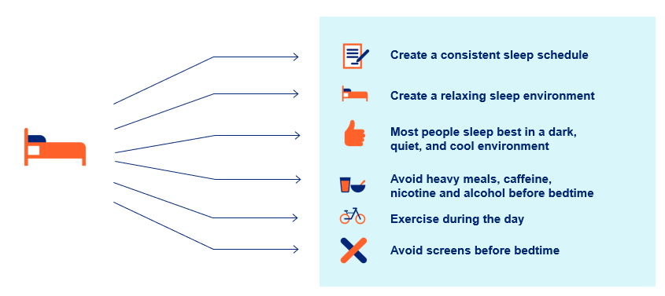
Good Sleep Tips
Notes:
8 Health Benefits of Sleep (sleepfoundation.org)
Good Sleep for Good Health | NIH News in Health
The Importance of Sleep Hygiene in the Treatment of Depression, Anxiety and Addiction (youtube.com)
Create a consistent sleep schedule.
A regular sleep and wake routine helps the body keep a consistent internal clock.
If you need to nap, keep naps to about 20 minutes. Naps that are too long can reduce alertness and defeat the purpose of napping.
Create a relaxing sleep environment.
Most people sleep best in a dark, quiet, and cool bedroom.
Too much light or noise at night can keep people awake or interrupt sleep.
An eye mask or blackout curtains can eliminate unwanted light.
Earplugs and noise machines can reduce distracting noises.
A fan can cool the room and serve as a noise machine.
Avoid heavy meals, caffeine, nicotine and alcohol before bedtime.
Avoid caffeine at least 6 hours before bed, ideally 12 hours.
Exercise during the day.
Daytime exercise can make it easier to fall asleep and daily exercise is associated with better sleep quality.
Avoid exercising at least 2 hours before bedtime.
Avoid screens before bedtime.
Sleep experts advise developing a relaxing routine in the hour before bedtime.
During this period of winding down, choose a restful activity such as reading or listening to guided meditations.

Slide 10

Group Discussion
Group Discussion

